Slide 1
Microsoft Forms +
Surveys with real-time custom dashboards
Ingeborg Hawighorst

Slide 2













Thank you to our sponsors

Slide 3
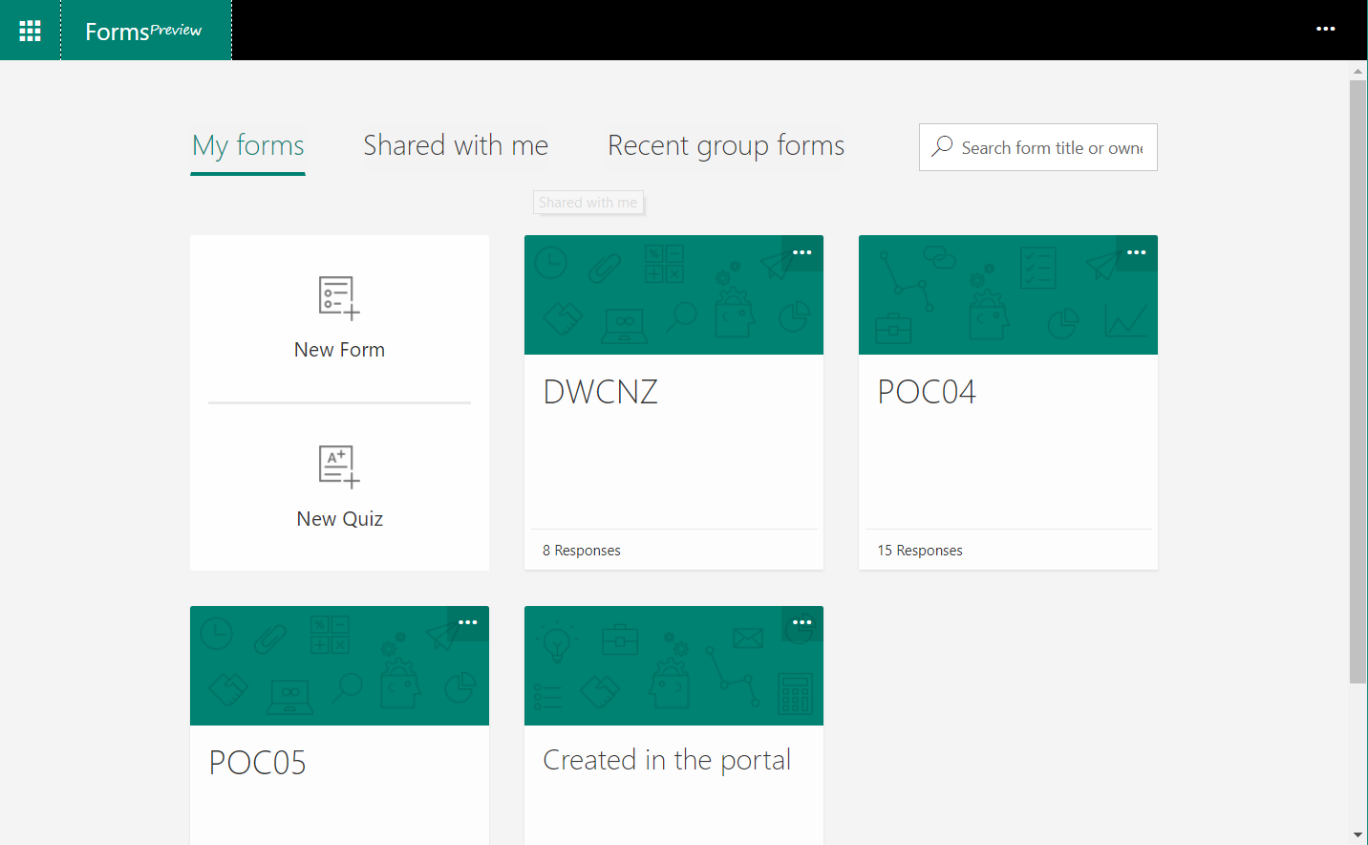
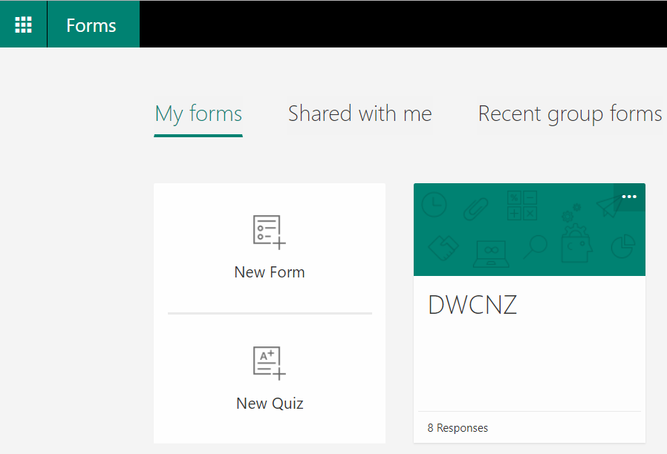

Slide 4
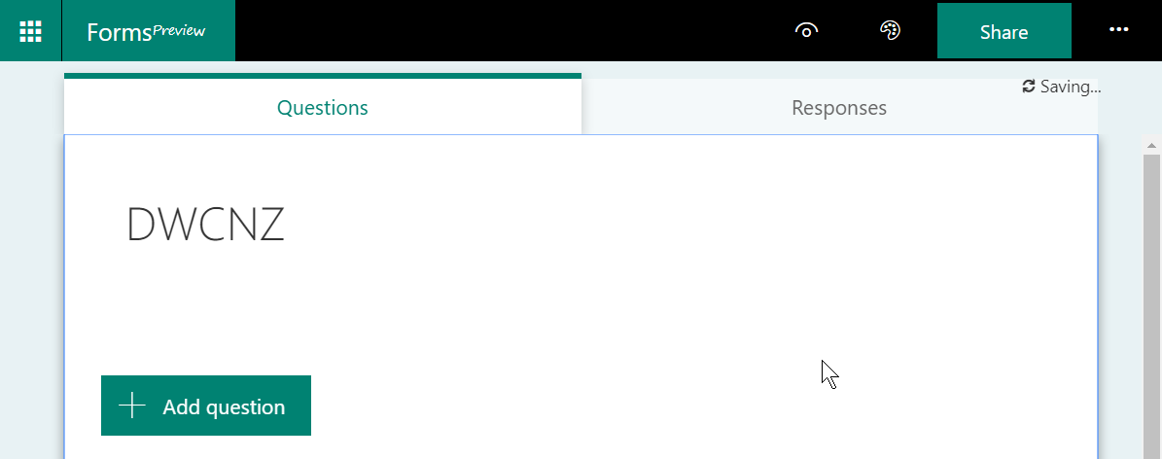
New forms open in the Forms editor

Slide 5
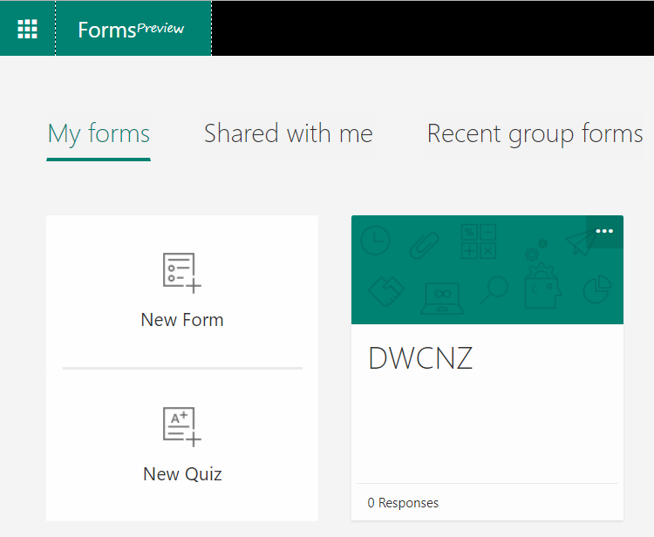
All Forms show in the portal

Slide 6
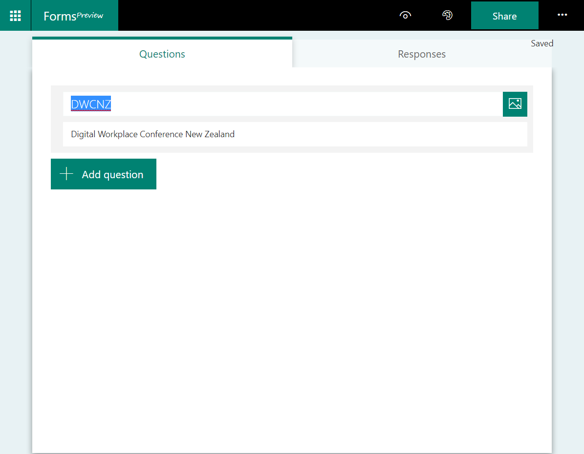
Edit the Form to add sub title …
… then start adding questions

Slide 7
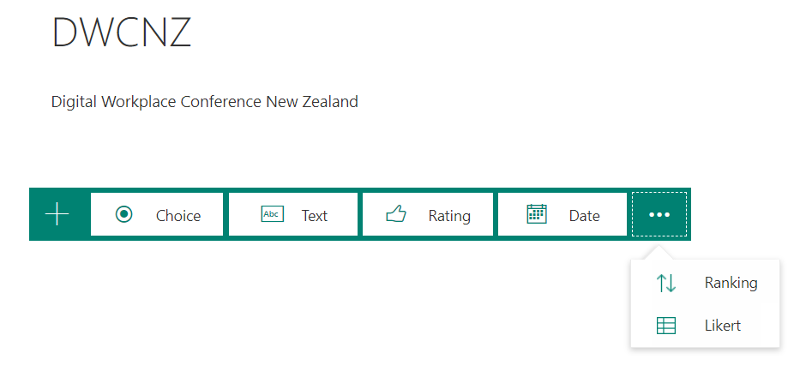
Question types

Slide 8
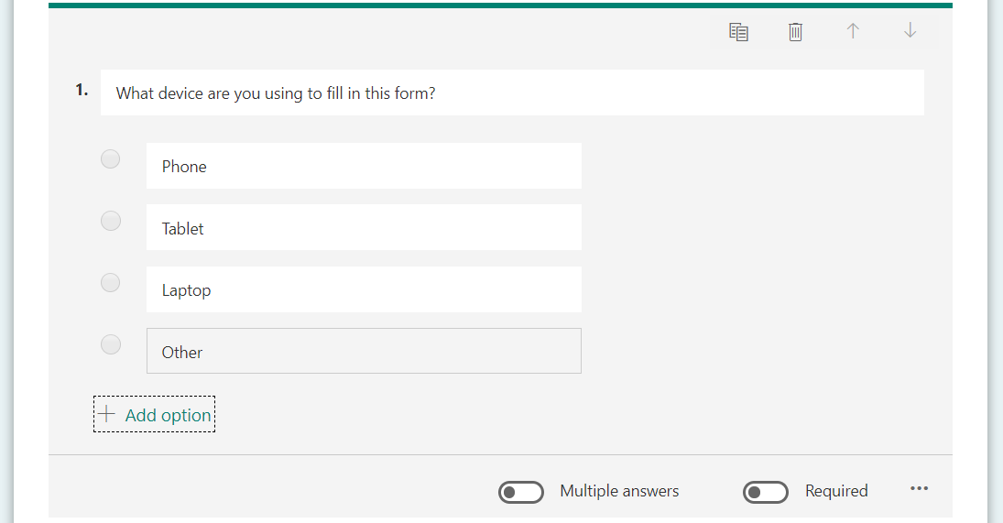
Choice

Slide 9
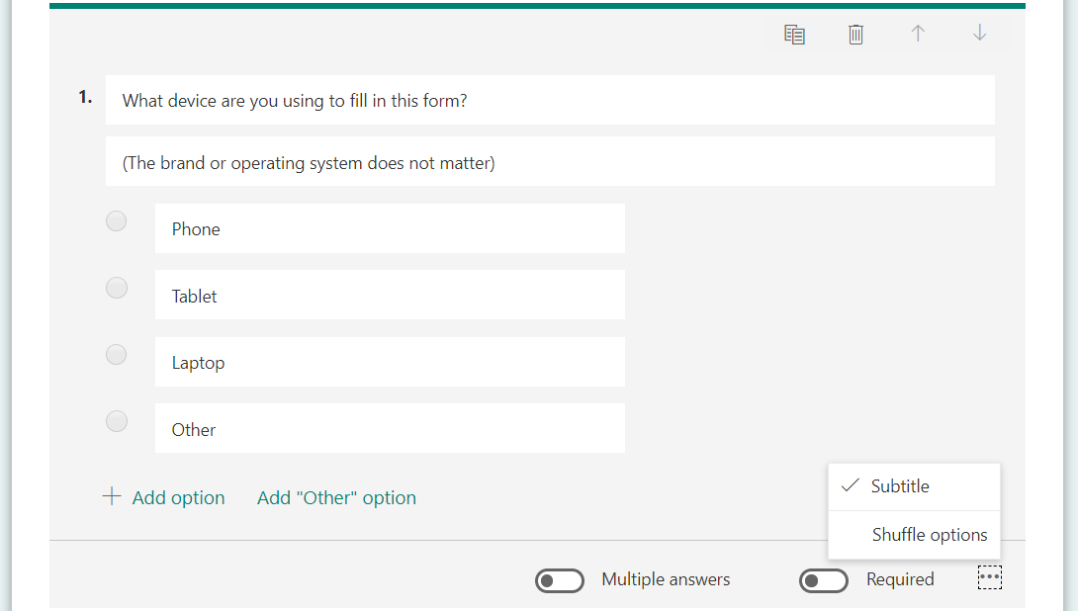
Questions can have subtitles

Slide 10
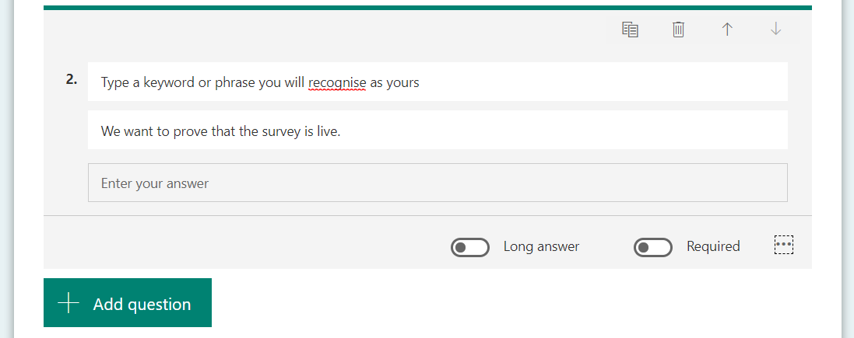
Text

Slide 11
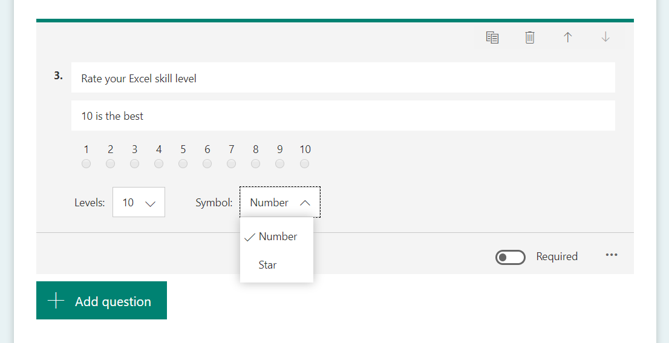
Rating
Number
Star
5 levels
10 levels

Slide 12
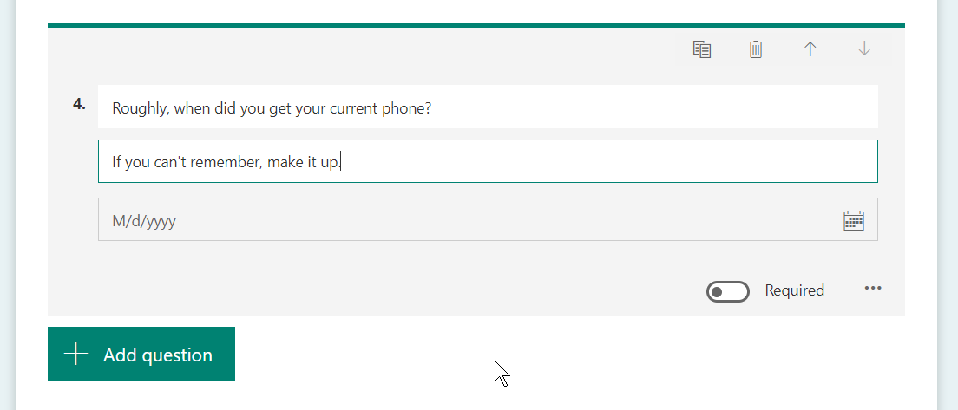
Date
Will show
device-specific
date picker

Slide 13
Ranking
Found in the “…” menu

Slide 14
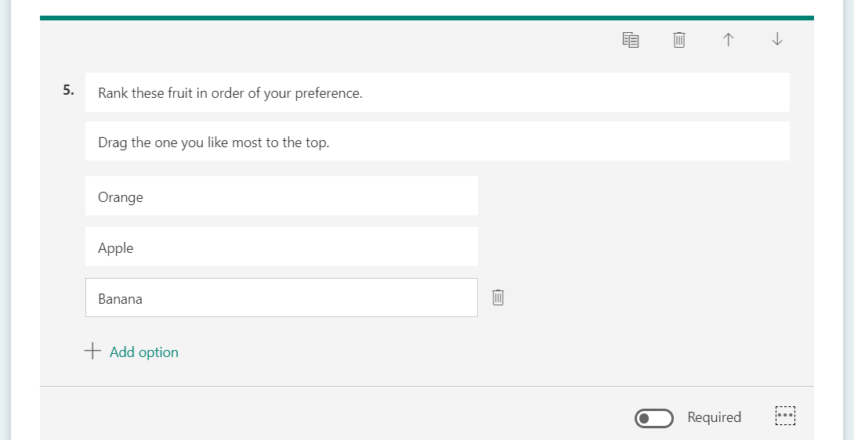
Ranking

Slide 15
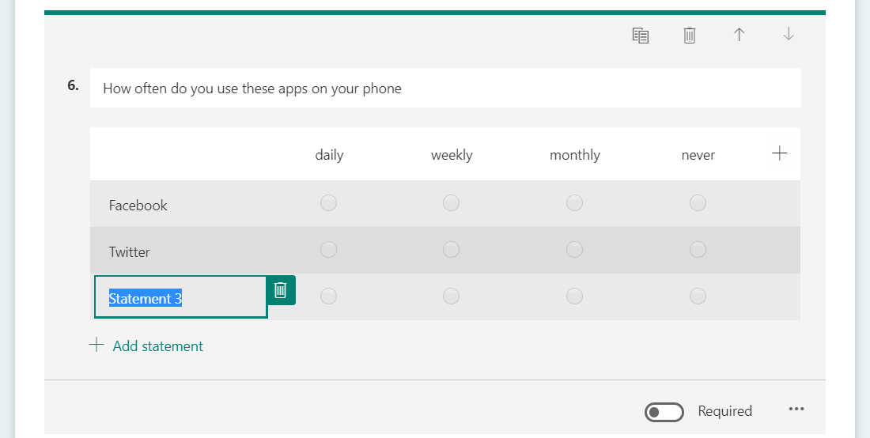
Likert
Statements
go in rows
Options in
columns

Slide 16
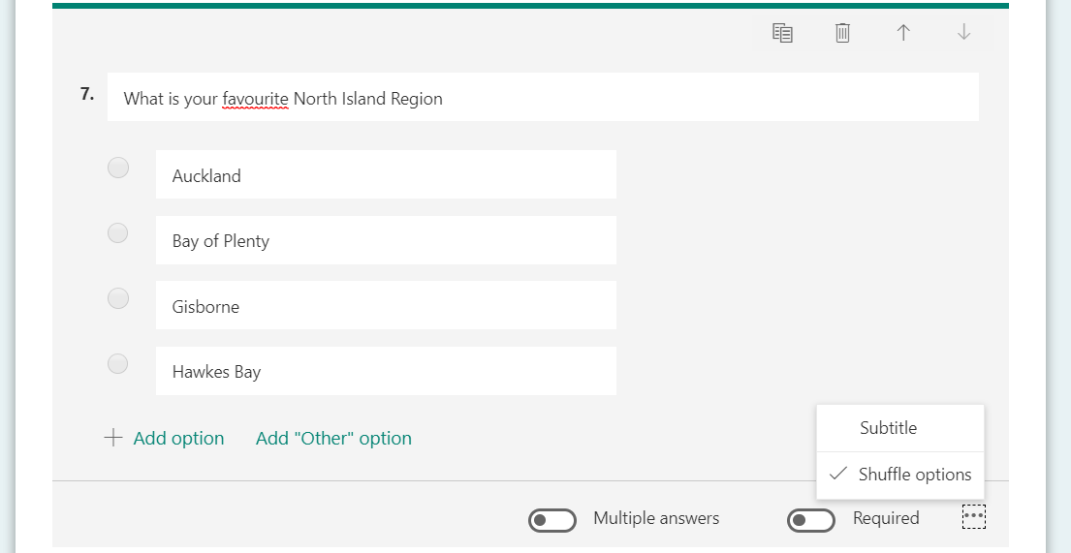
Choice options can be shuffled

Slide 17
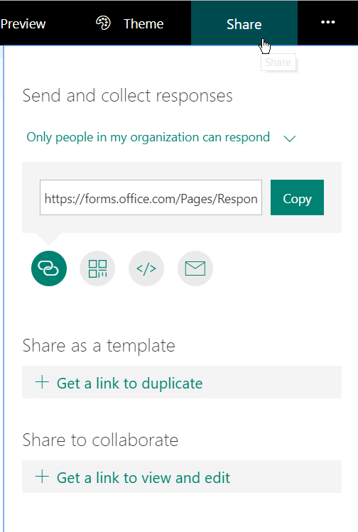
Share a Form
Organisation – will use your
Office 365 credentials
Your name and email address
will show in the result

Slide 18
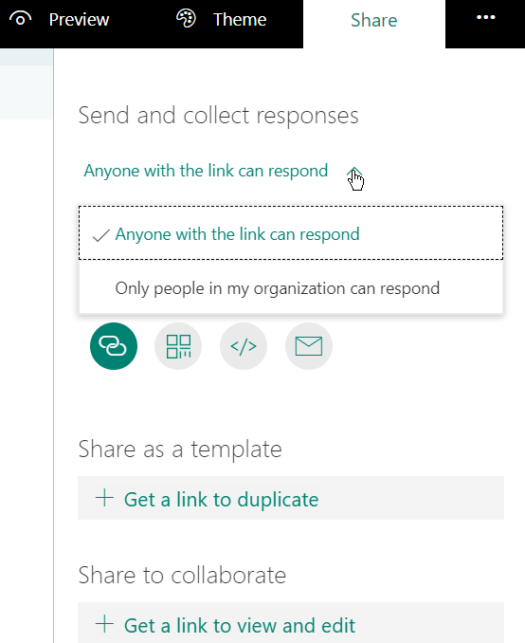
Share a Form
Anyone with the link
Replies will be anonymous
Tip: run the URL through Bit.ly

Slide 19

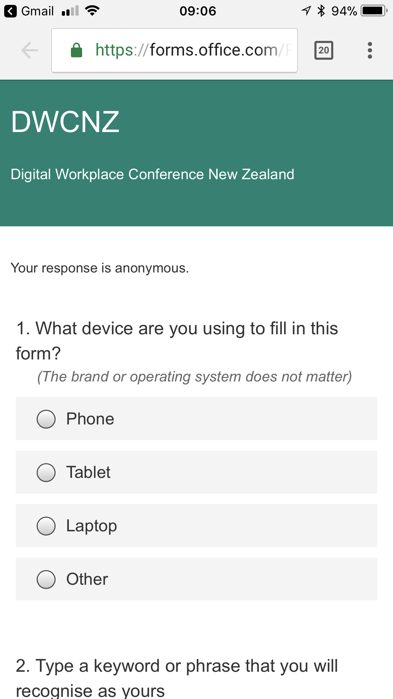

Slide 20
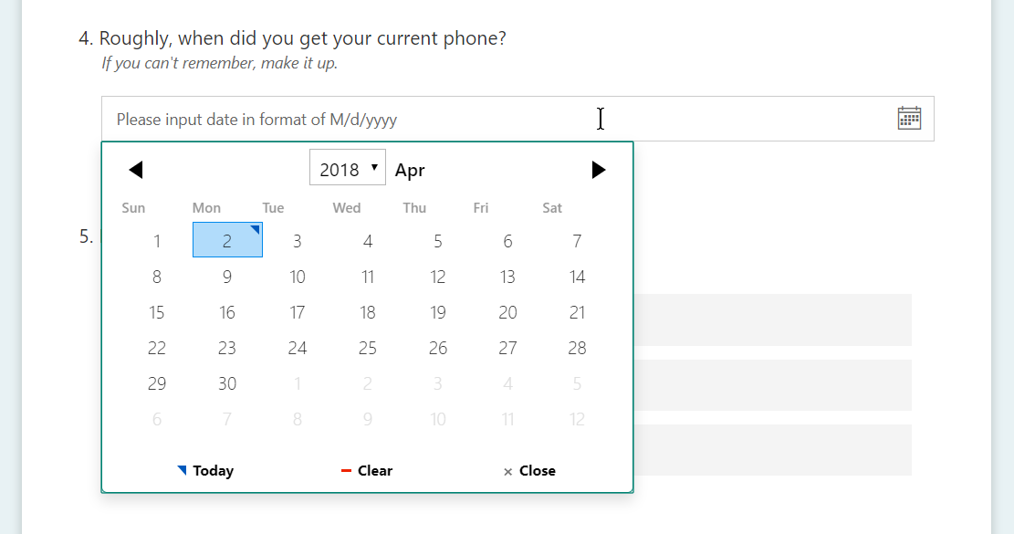
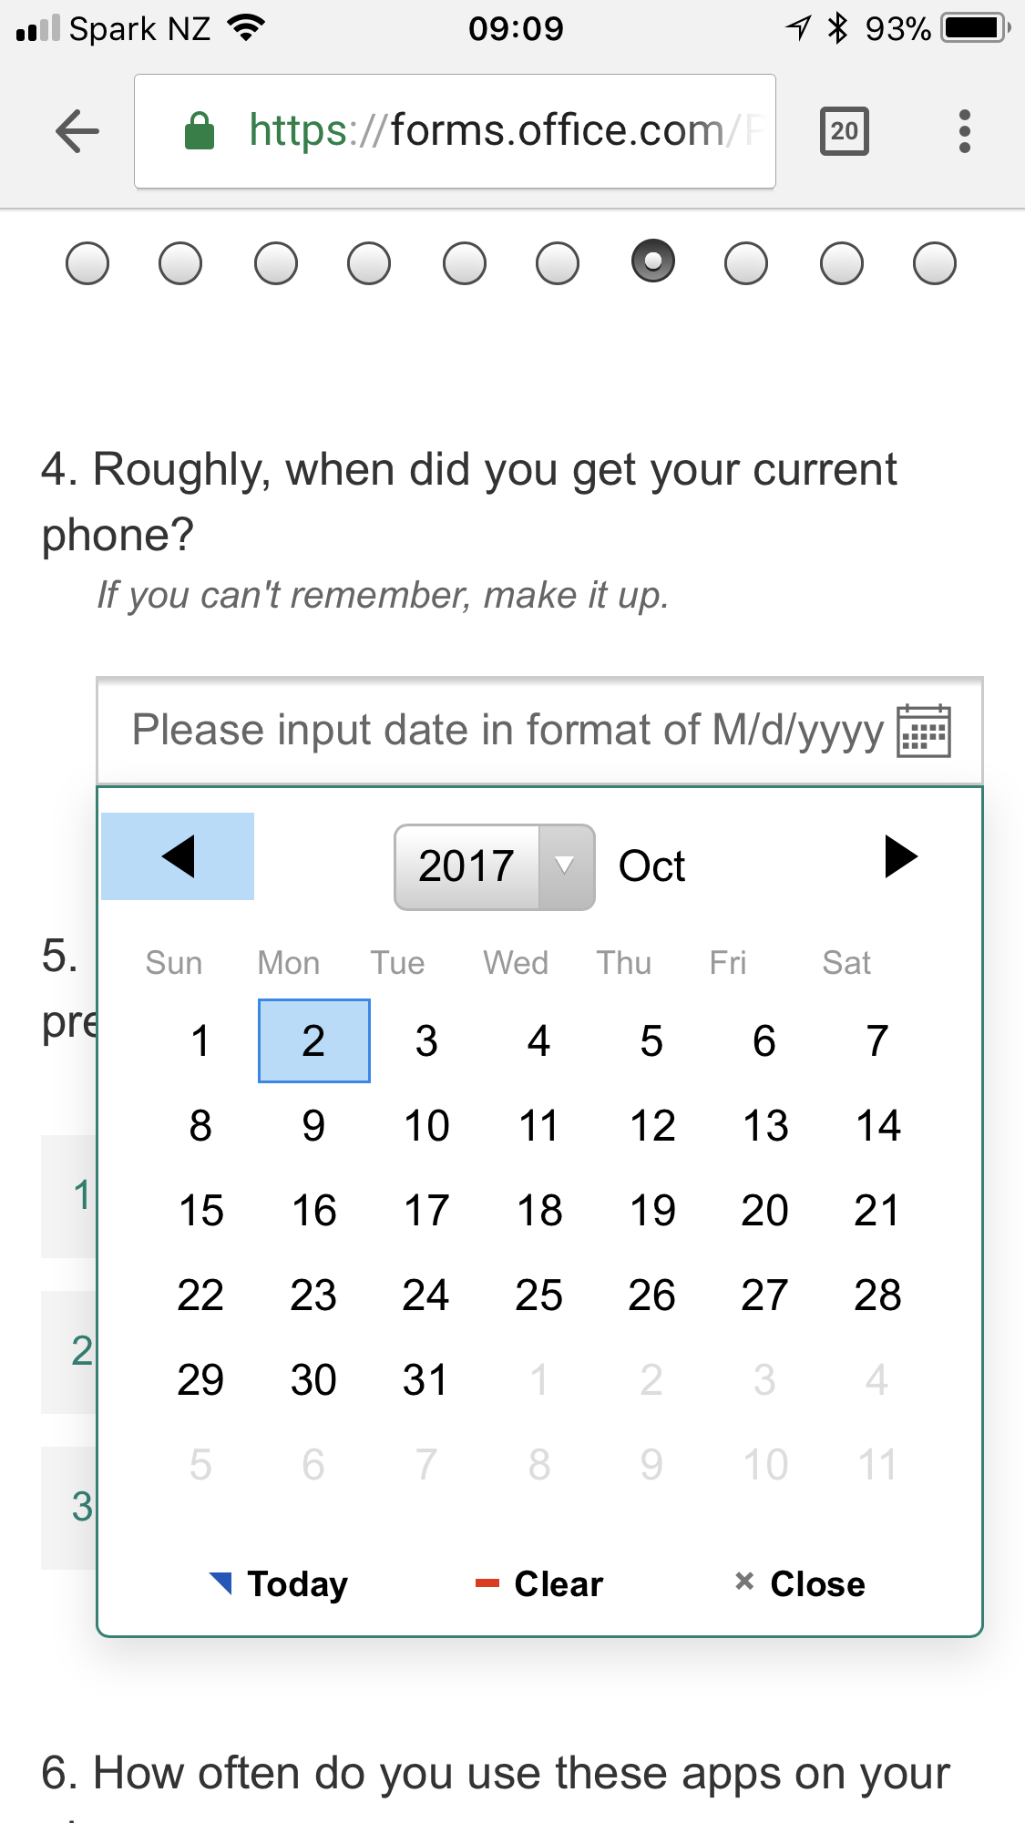
Date picker

Slide 21
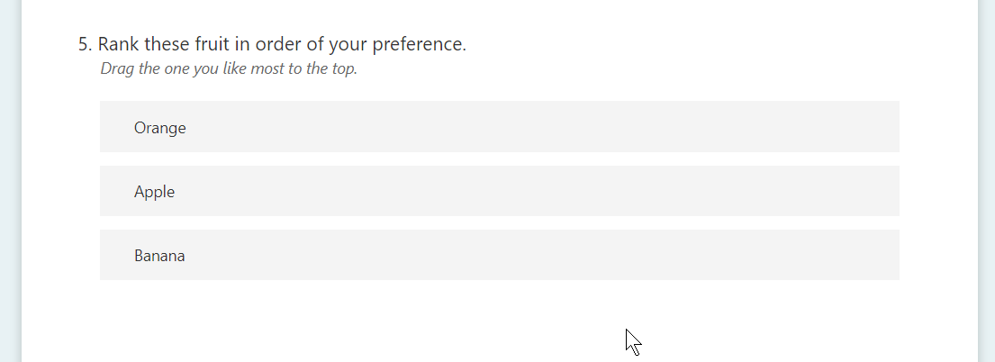
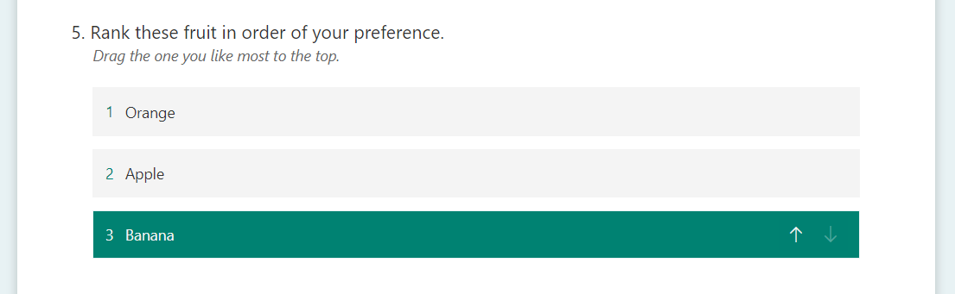
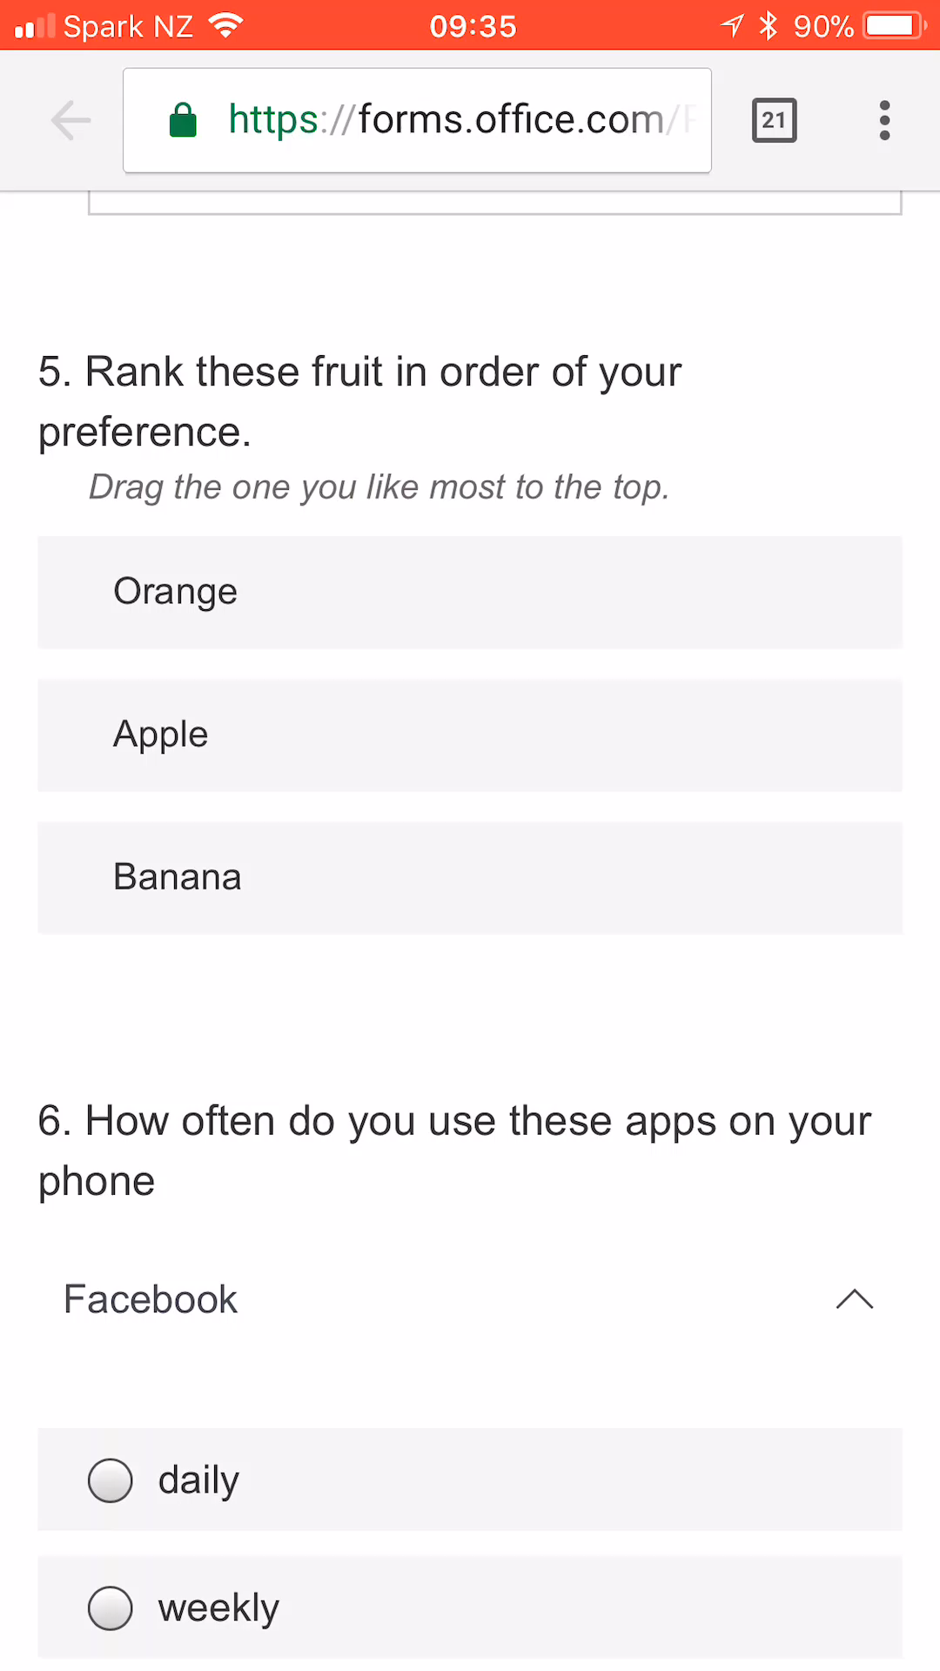
Ranking

Slide 22
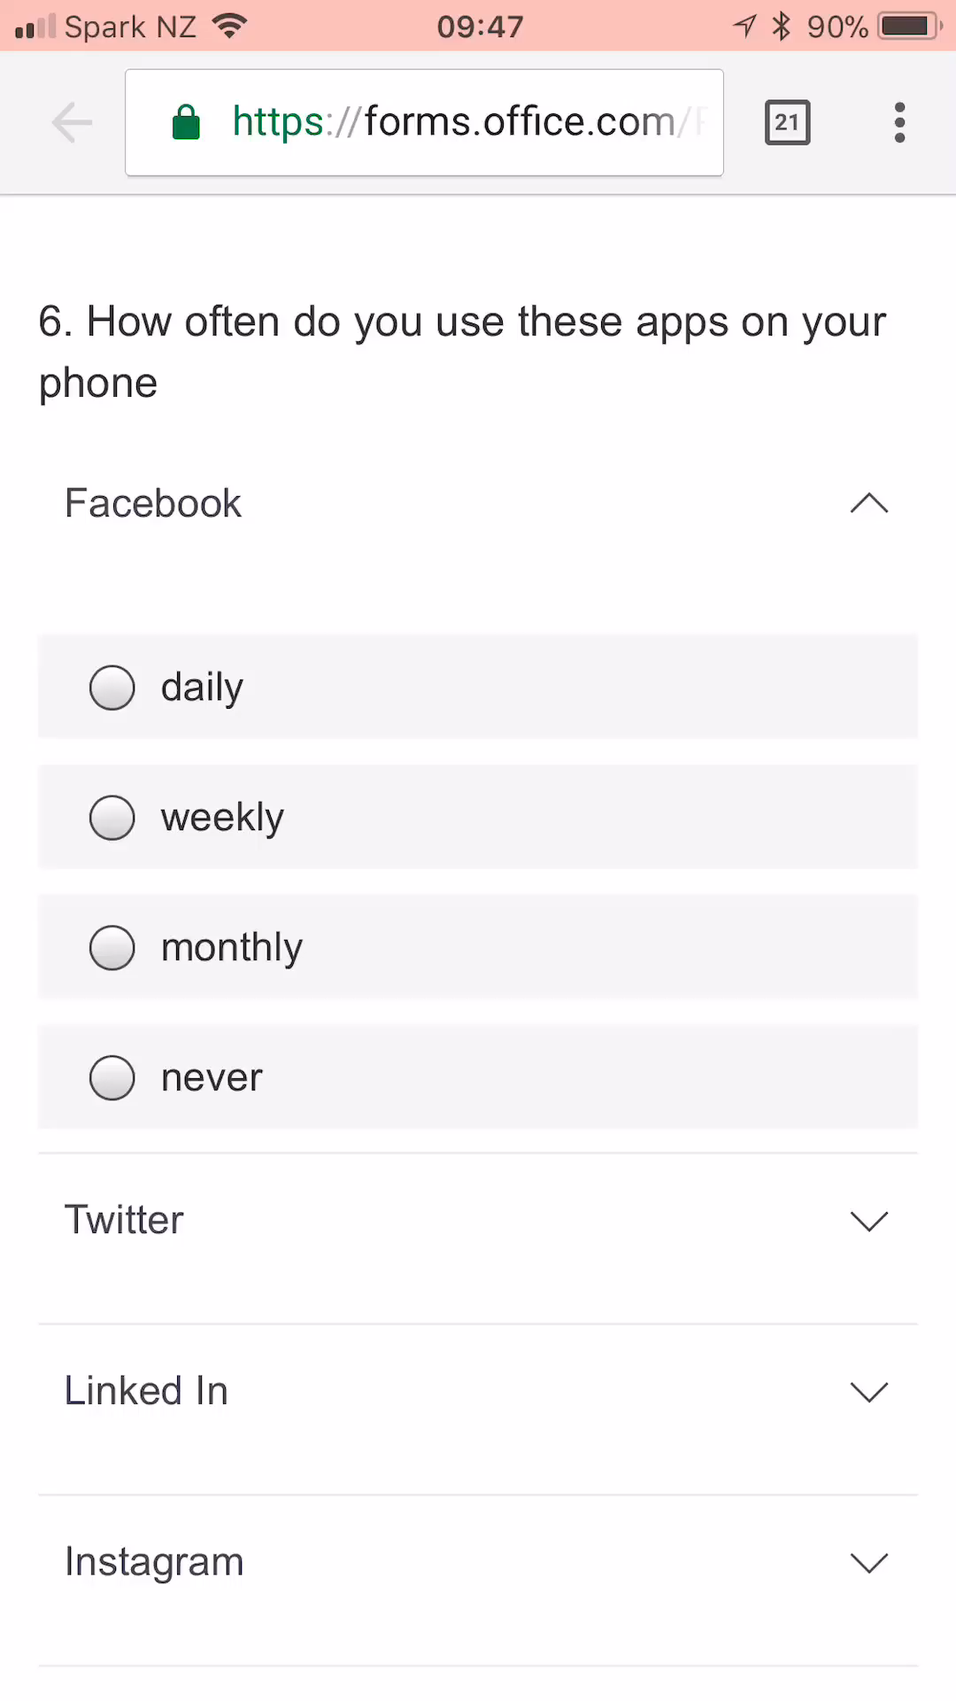
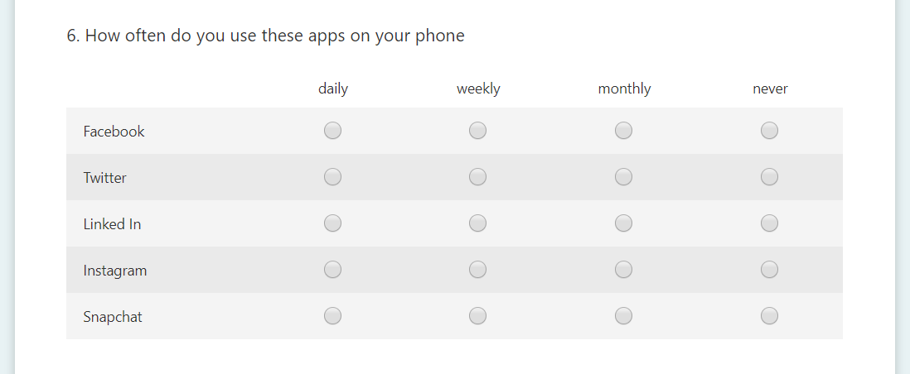
Likert scales

Slide 23
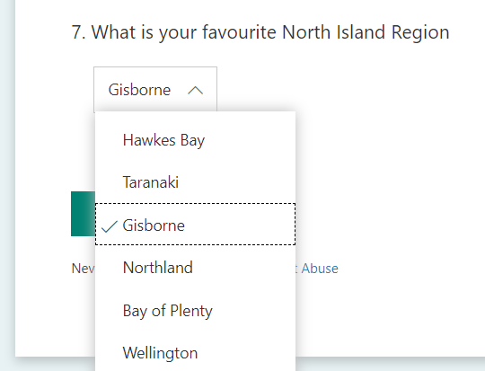
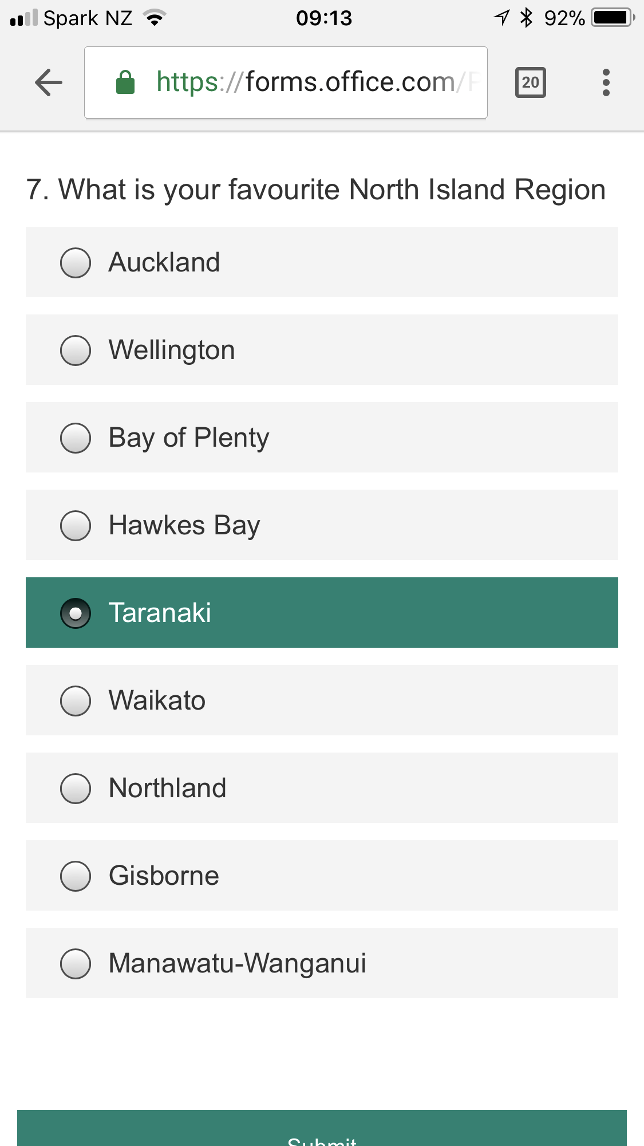
Randomised choice

Slide 24
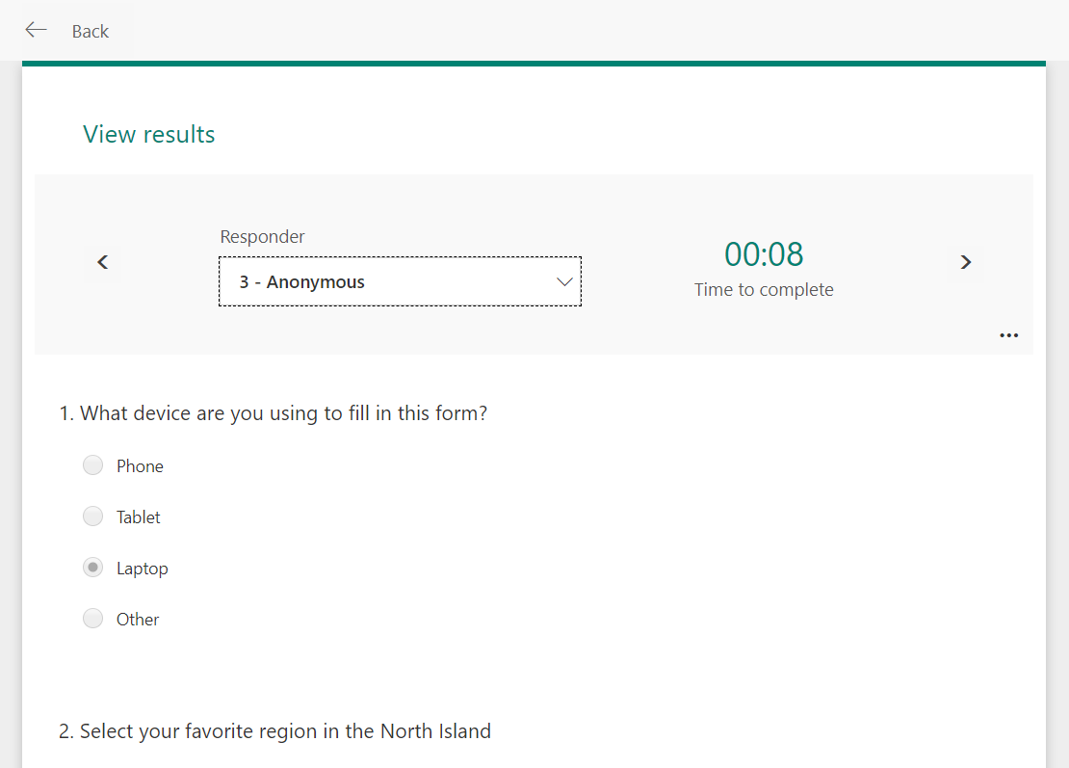
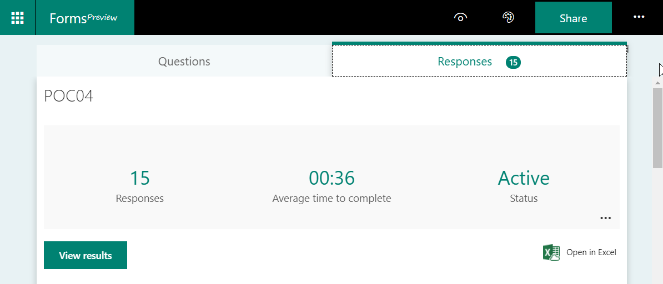
Form responses

Slide 25
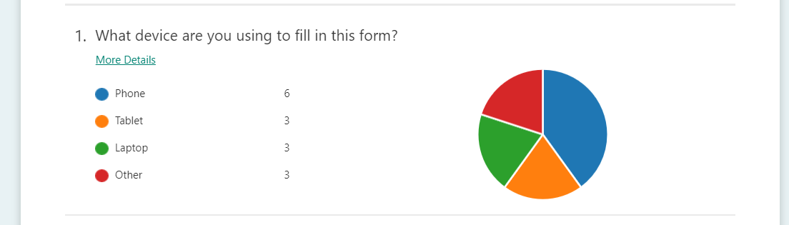
Choice > Pie chart
Save the Pies for Dessert – Stephen Few
Choosing a chart – Recorded at Microsoft Production Studios

Slide 26
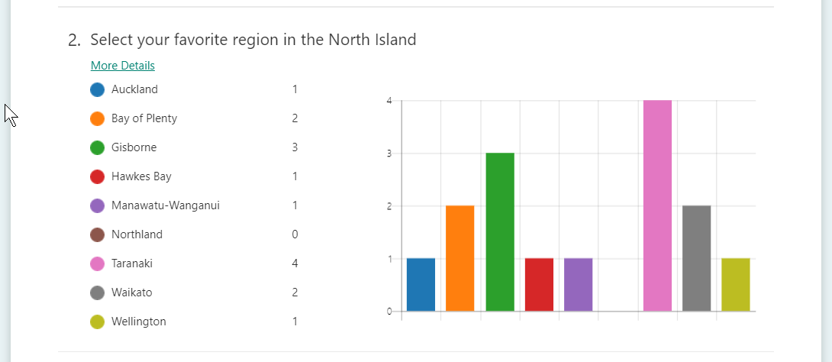
Choice > Column chart

Slide 27
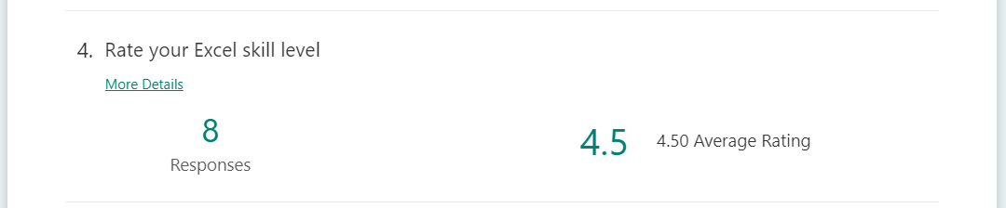
Rating > Average Rating

Slide 28

Date > last three dates

Slide 29
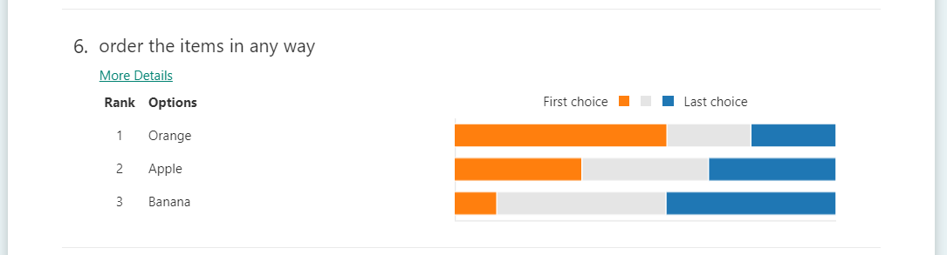
Ranking

Slide 30
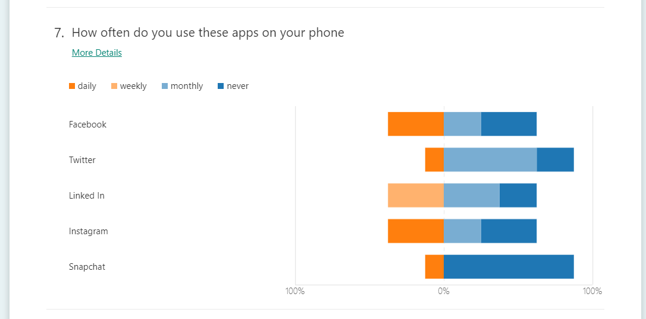
Likert

Slide 31
Issues
A lot of scrolling
Wrong chart types for the data are hard to read
Not much “insight” into the information

Slide 32
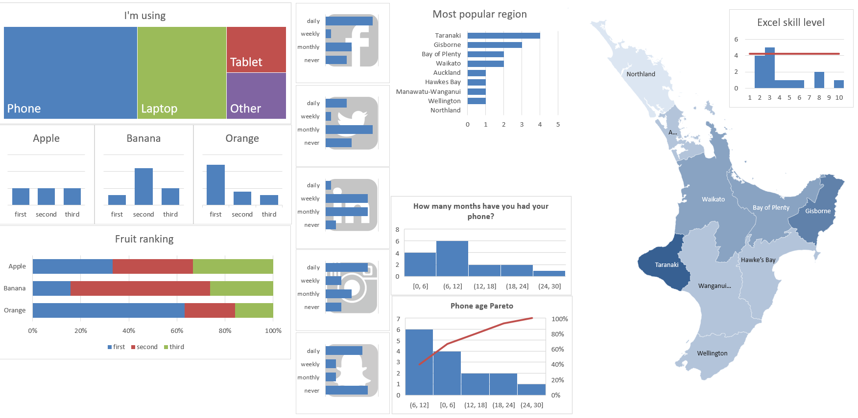
Dashboard with everything at a glance
Dashboard screenshot

Slide 33
View results in Excel

Slide 34
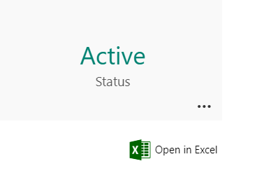
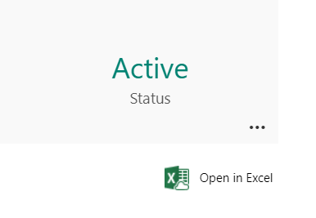
Little icon – Big difference
Created in the portal
Created in OneDrive for Business or SharePoint

Slide 35
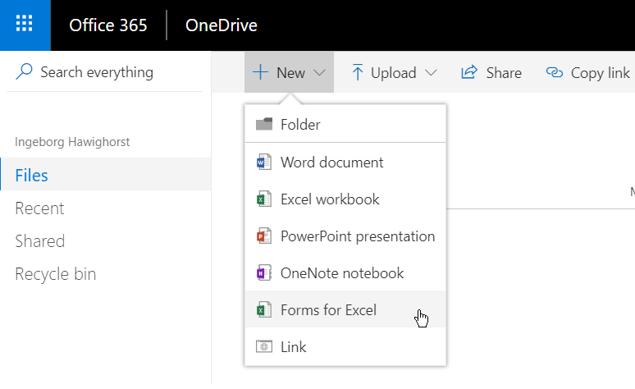
Adding Forms in OneDrive

Slide 36
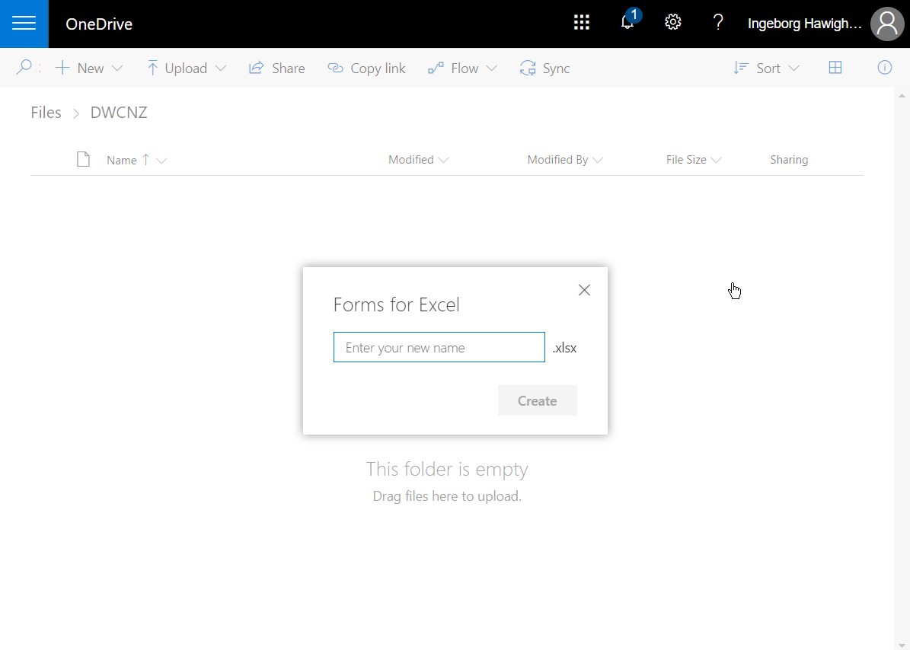
The form name is the workbook name

Slide 37
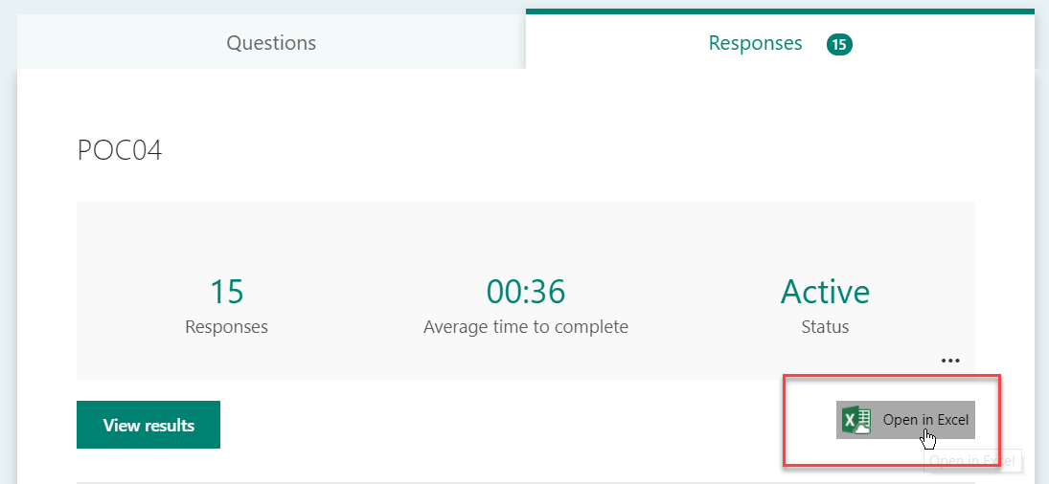
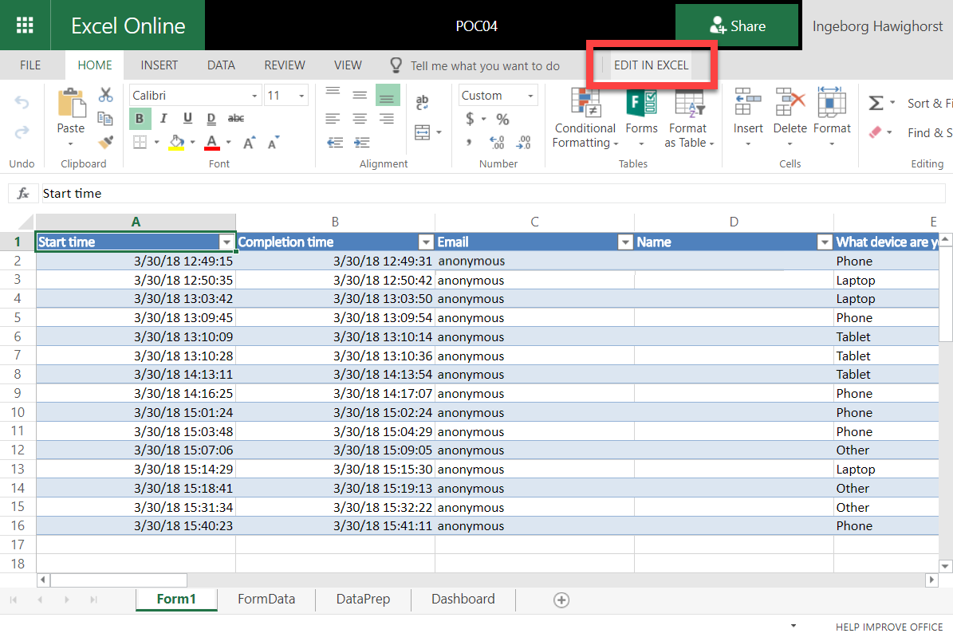
Initial setup - Open the Form in Excel
Open Form in Forms Portal
Click link to edit in Excel, will open in browser
Click command to Edit in Excel

Slide 38
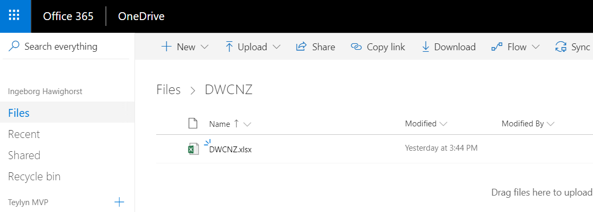
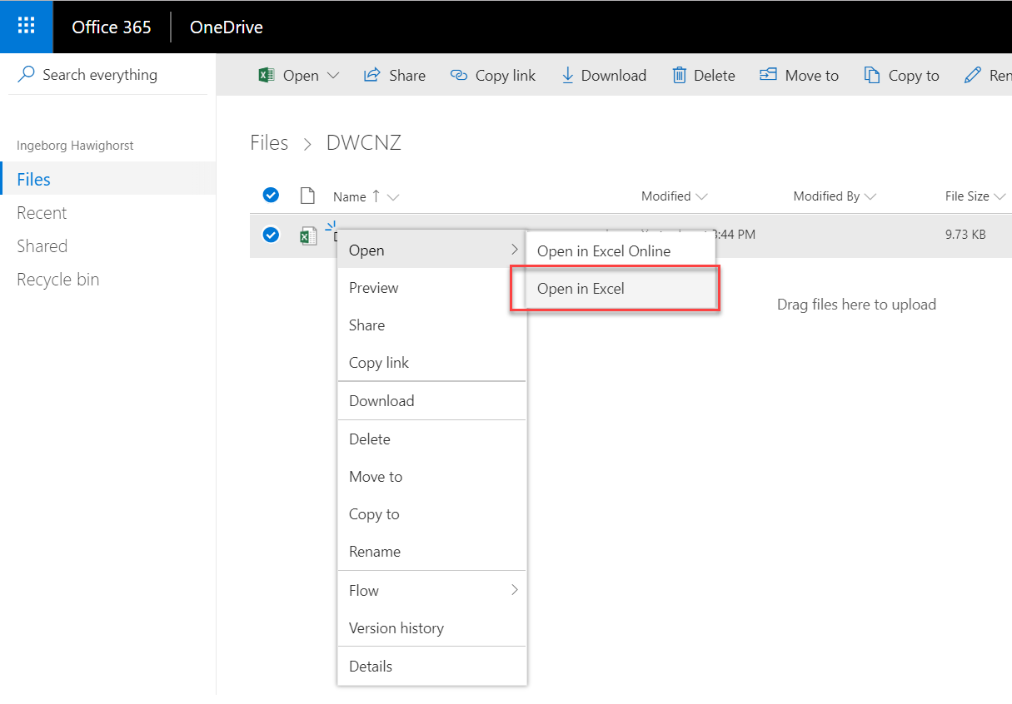
Initial setup - Open the Form in Excel
Open OneDrive for Business
Open Form workbook in Excel
Open the OneDrive for Business folder on your PC and edit the Form workbook

Slide 39
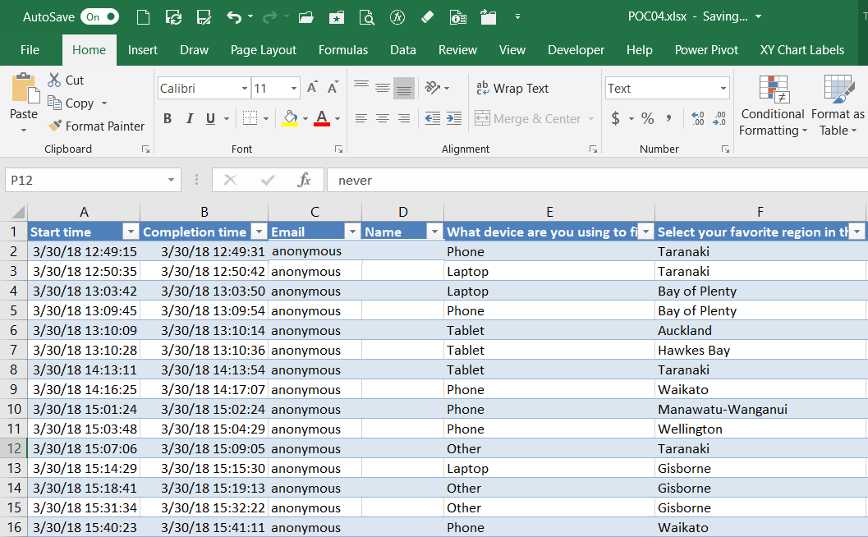
Worksheet Form1
Has all responses to the Form
Do NOT manipulate this sheet
Don’t add or remove or edit data
It will break the Form
Instead: Create a dynamic copy of the data
EVER!
EVER!

Slide 40
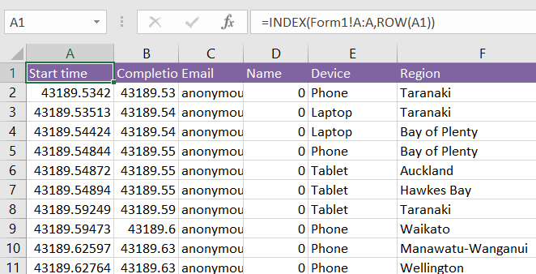
Dynamic data
=INDEX(Form1!A:A,ROW(A1))
Insert a new sheet
Rename to “FormData”
Formula options
  =Form1!A1
  Will break with new data
  =INDEX(Form1!A:A,ROW(A1))
  Will work
  Copy across and down
  Estimate the number of expected responses

Slide 41
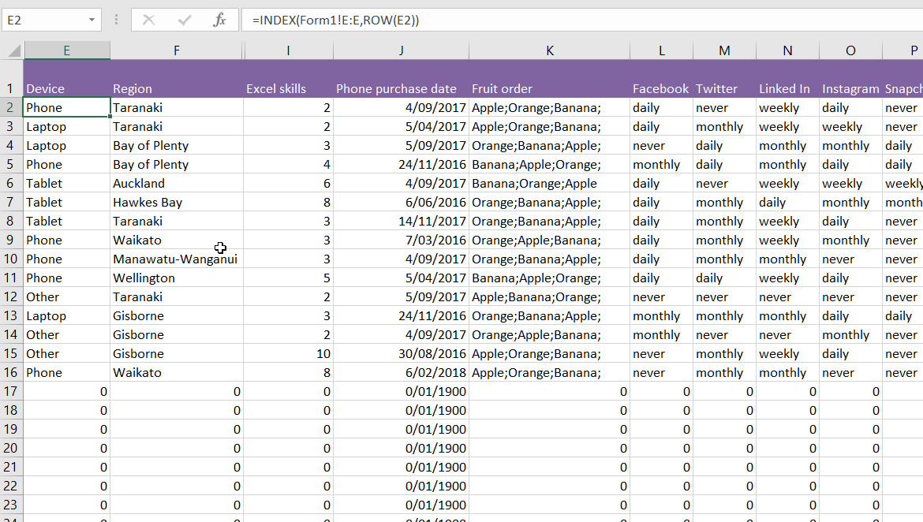
Benefits of data copy
No need to manipulate original data
Enter fake data for testing
Rename column headings
Hide unused columns

Slide 42
Data preparation - approach
Create a new sheet for data preparation and one for the Dashboard
Arrange data for each chart on the Data Prep sheet
Create the chart
Move chart to Dashboard sheet
Data layout and preparation will vary for each chart

Slide 43
Choice > Pie chart
Save the Pies for Dessert – Stephen Few
Choosing a chart – Recorded at Microsoft Production Studios

Slide 44
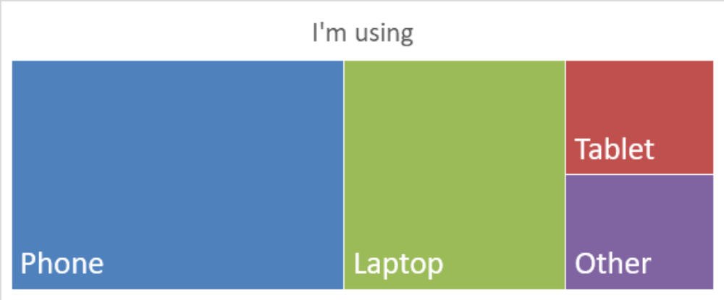
Choice > Pie chart
Treemap

Slide 45
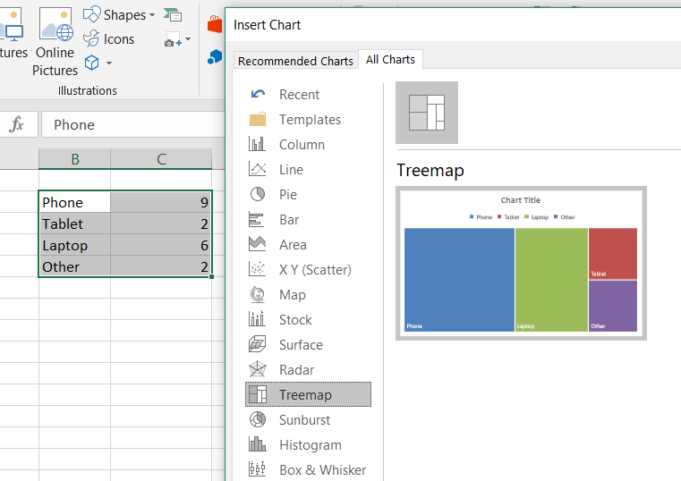
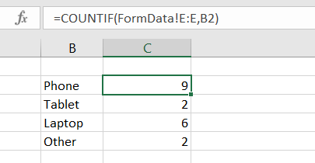
Treemap chart data
Type all devices into cells
Count devices in the FormData
Select the data and insert
a Treemap chart
=COUNTIF(FormData!E:E,B2)

Slide 46
Choice > Column chart

Slide 47
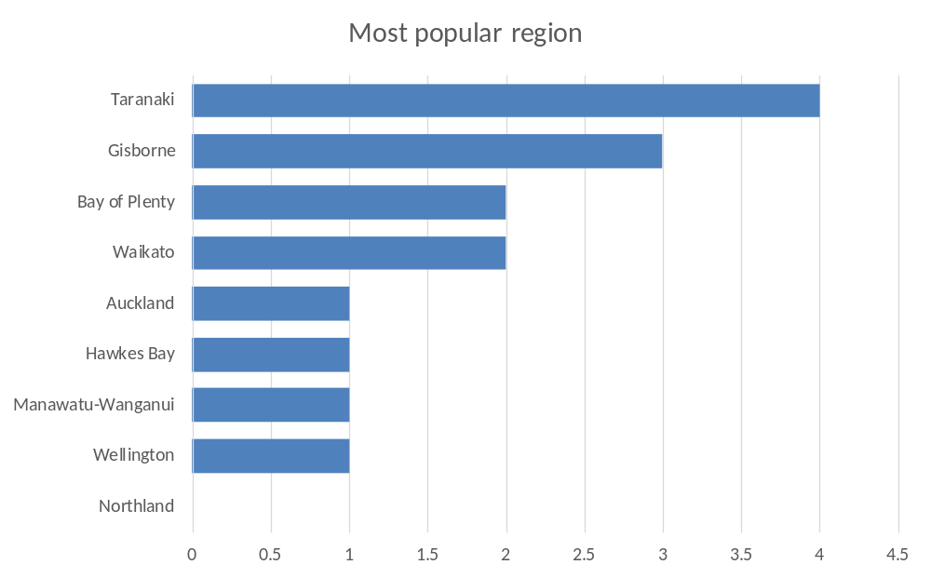
Choice > Column chart
Horizontal Bar Chart
Sorted by values
Easy to read

Slide 48
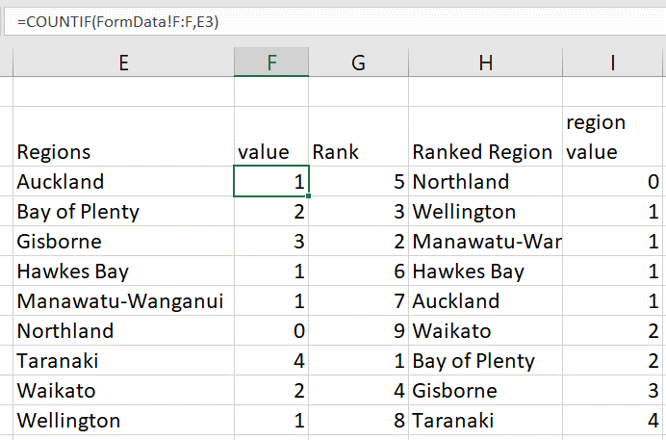
Ranked Bar Chart – get the data
=COUNTIF(FormData!F:F,E3)
Manually enter the region names
into the cells
Count each region name in the
FormData sheet
Duplicate values hard to rank

Slide 49

Ranked Bar Chart – rank the values
=RANK.EQ(F3,$F$3:$F$11,0)
Duplicate values

Slide 50

Ranked Bar Chart – rank with tie break
=RANK.EQ(F3,$F$3:$F$11,0) +COUNTIF($F$3:F3,F3)-1
Avoid duplicates by adding a
count of the same value up to
the current row
From absolute reference $F$3
to current row in column F

Slide 51

Ranked Bar Chart – order region by rank
=INDEX($E$3:$E$11,
MATCH(
LARGE($G$3:$G$11,ROW(A1)),
$G$3:$G$11,0))

Slide 52

Ranked Bar Chart – Lookup region value
=VLOOKUP(H3,$E$3:$F$11,2,FALSE)

Slide 53

Select data – insert chart

Slide 54

Choice > Column chart
Filled Map
Works only in Excel for desktop, not Excel Online

Slide 55

Tweaking the map
Column header must be “Regions”
Format data series
  Map area: Only regions with data
  to hide the South Island
Increase chart size to zoom into map
Move to edge of the screen and
overlay with other content to
mask empty chart area space

Slide 56

Rating > Average Rating
Histogram with Average line

Slide 57

Skills Histogram – get data
=FormData!I2+0
Source data is text
Coerce to number by adding 0
Copy down as far as required

Slide 58

Skills Histogram – create bins and average
=COUNTIF(M:M,O3)
Manually enter the bins 1 to 10
Count the bins in the data
Put Average formula in first and
last row of chart data table
Average only numbers greater
than 0
=AVERAGEIF($M$3:$M$101,"<>0")

Slide 59

Skills histogram – create chart
Leave top left cell empty
if data is numeric, otherwise
Excel will plot these as a series
Change the chart type to
combo with line
Format columns with gap
width = 0

Slide 60

Date > last three dates
Age histogram and Pareto

Slide 61

Phone age – get data
=IF(FormData!J2>0,
DATEDIF(FormData!J2,TODAY(),"M"),NA())
DATEDIF calculates difference in time units,
“M” for months
Charts ignore cells with #N/A

Slide 62


Phone age histogram and Pareto
Select any cell in the data column
Insert histogram
Format data series to set bin size
Repeat for Pareto

Slide 63

Ranking > 100% stacked bars
Trellis / panel charts

Slide 64

Trellis chart – data preparation
Pull from the FormData sheet
=FormData!K2
Split off the first element with a LEFT() function
Split off the second element with a SUBSTITUTE and LEFT
Split off the third element with
nested SUBSTITUTE
Relax …

Slide 65
Trellis chart – data preparation
=FIND(";",AC3)
=FIND(";",AC3)-1
=LEFT(AC3,FIND(";",AC3)-1)
=IFERROR(LEFT(AC3,FIND(";",AC3)-1),””)
To split off the first element
Find the position of the semicolon
Subtract 1 to arrive at ‘n’
Get the leftmost ‘n’ characters
If the result is an error, return an empty text

Slide 66

Trellis chart – data preparation
=AD3&";"
=SUBSTITUTE(AC3,AD3&";","")
=FIND(";",SUBSTITUTE(AC3,AD3&";",""))-1
=LEFT(SUBSTITUTE(AC3,AD3&";",""),
FIND(";",SUBSTITUTE(AC3,AD3&";",""))-1)
To split off the second element
Append a semicolon to the first
element
Swap that out for nothing in the list of elements. The result will be “Orange;Banana;” – no more apples
Find the position of the first semicolon and subtract 1 for ‘n’
Return the ‘n’ leftmost characters from the shortened list

Slide 67

Trellis chart – data preparation
=AD3&";"&AE3&";"
=SUBSTITUTE(AC3, AD3&";"&AE3&";","")
=SUBSTITUTE(SUBSTITUTE(AC3, AD3&";"&AE3&";",""),";","")
To split off the third element
Append the first and second
elements with semicolons
Swap that out for nothing in the list of elements. The result will be “Banana;” – no other fruit left
Substitute any semicolon with an empty text
Enjoy the banana

Slide 68

Trellis chart – data preparation
Create a matrix
Fruit in the first column
Place in the first row
Countifs counts each
fruit occurrence
=COUNTIFS(AD:AD,$AH3)

Slide 69


100 % Stacked Bars
Create this
look
Insert 100%
Stacked Bar
chart

Slide 70


Trellis chart – chart prep
Select the data and create a
Stacked Column chart
Format the series gap width
to 50%

Slide 71



Trellis chart – chart prep
Copy the chart
Drag the series
highlight to the
next row
Repeat for the
next chart
Problem: charts may have different scales

Slide 72

Trellis chart – chart prep
All charts need the same axis scale
Hence all charts need to have the same largest number
Look at the largest number in all the data
Stack the difference to the FIRST column of each chart

Slide 73

Trellis chart – Helper series
Find the largest number in the data
=MAX($AI$3:$AK$5)
Subtract the value of the first column
Stack this result as a new series

Slide 74




Trellis chart – helper series
Copy the number
to be stacked
Select the chart
Use Paste Special
Tick “New Series”
Click OK
Format the series
with no fill to make
it invisible
Put the title back and repeat for the other charts

Slide 75

Likert > 100% stacked
Trellis / panel charts

Slide 76


Social Trellis – data preparation
Source data in columns
Create matrix with channels
across the top, values in the
first column
Count how many times
each value appears in the
channel’s column
=COUNTIF(FormData!L:L,$AP3)

Slide 77

Social Trellis – data preparation
Helper cells for the stacked series
that ensures the scale is the same
for all charts.
=MAX($AQ$3:$AU$6)-AQ3

Slide 78


Social Trellis – data preparation
Select one column of data and the axis
labels and insert a stacked horizontal bar
chart
Copy the helper cell and use Paste Special
to paste it as a new series
Format the helper series invisible
Optional: use an image as the plot area
background instead of a chart title
Rinse and repeat for the other social data

Slide 80

Fill in the survey
bit.ly/FillDWCNZ

Slide 81


Thank you to our sponsors

